Slide 1

OutWrite
Marisa Yamasaki
Alisha Meherally
Kevin Jung
Fengjun Dong
Image from thenounproject.com
Notes:
17.05

Slide 2
Overall Problem
Notes:
48.64

Slide 3

Meet the writer!
Robin -- a student who writes an hour every night
Comes up with ideas throughout the day, but loses her notes
https://pixabay.com/
Notes:
This is Robin. She’s a student, but she’s loved to read for years. She’s dealing with her classes, homework, and a job, but she wants to write a novel. She’s decided she can devote an hour to her project every night to write.
Robin comes up with ideas everywhere for her book, but she keeps losing whatever paper she writes them down on.
Robin also struggles keeping her characters and her plot in order, since she just started and she’s been writing them all over the place.

Slide 4

The problem
On her feet throughout the day; can’t write down ideas in a systematic way
Loses track of details about characters and plots
https://pixabay.com/
Notes:
Robin’s on her feet a lot, and can’t always write down her ideas so they get lost, and her characters are all out of order… she wants to write, she really does, but she barely has any time for anything.
She keeps forgetting her ideas, and she keeps losing track of her characters and where her plot points go… no matter how much she wants to remember them…
She’s on the verge of giving up.

Slide 5

The solution!
OutWrite!
Uses QuickNotes to write down ideas throughout her day
Uses OutlineIt to keep track of characters and plots
Automatically syncs with her computer
https://pixabay.com/
Notes:
Robin is now able to write notes on the go using the quick note feature so she doesn’t lose track of her ideas when she’s busy at work.
She is also able to keep track of characters and of outline points on her phone so that she is able to develop plot points while bussing tables
She can then go home and sync all these with the desktop version of the app.

Slide 6
Initial Prototype
Notes:
1.09.93

Slide 7
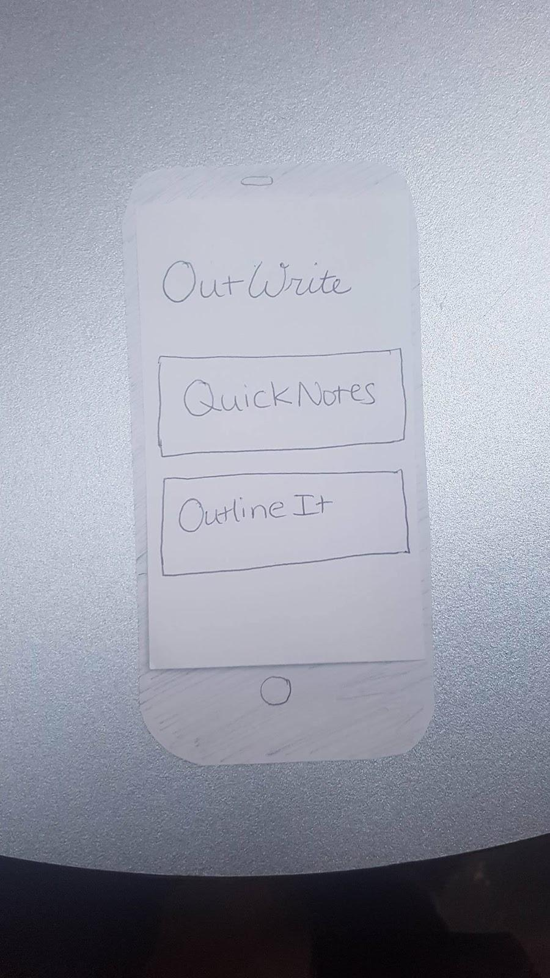
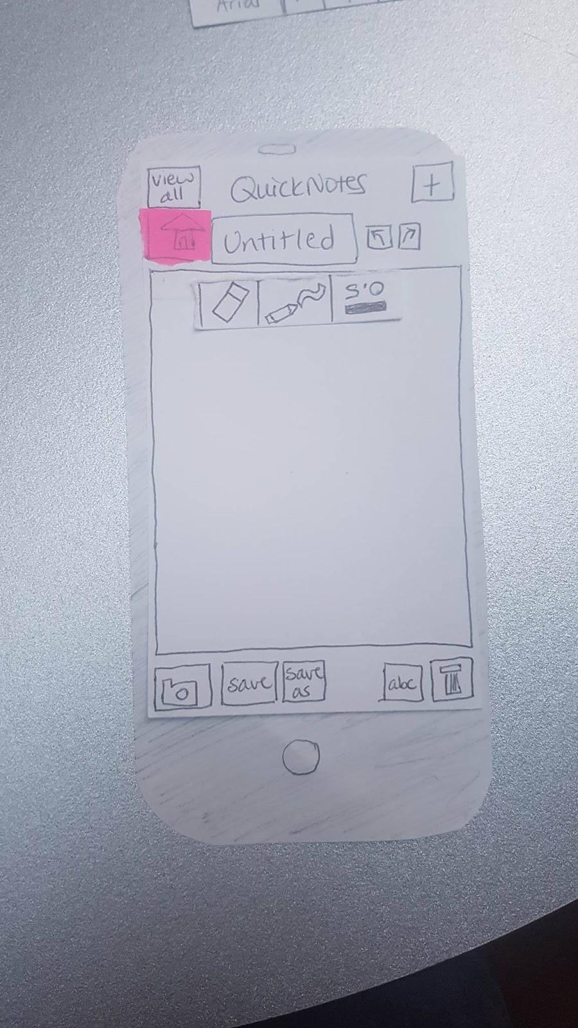
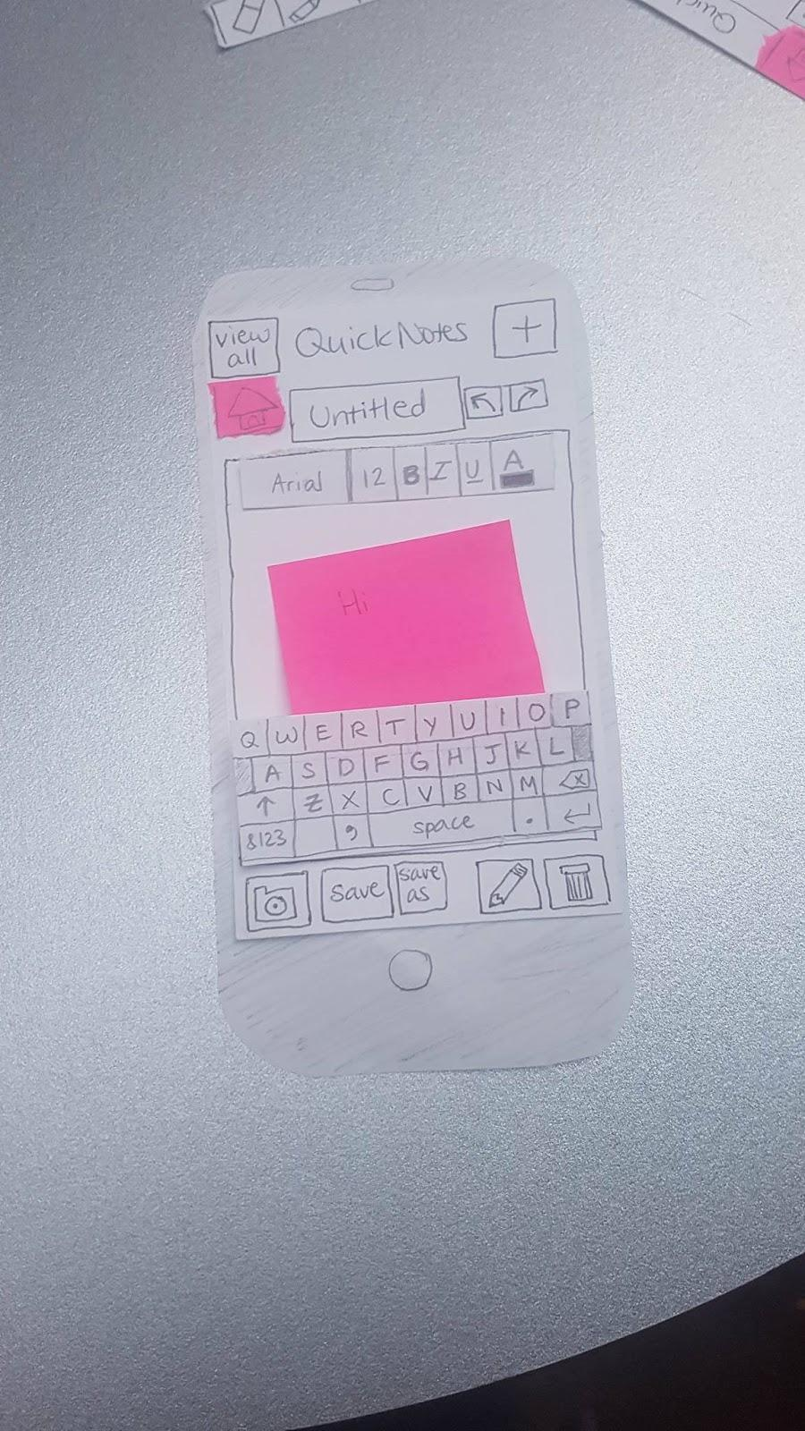
Task 1: Creating a new note and embedding a photo

Slide 8
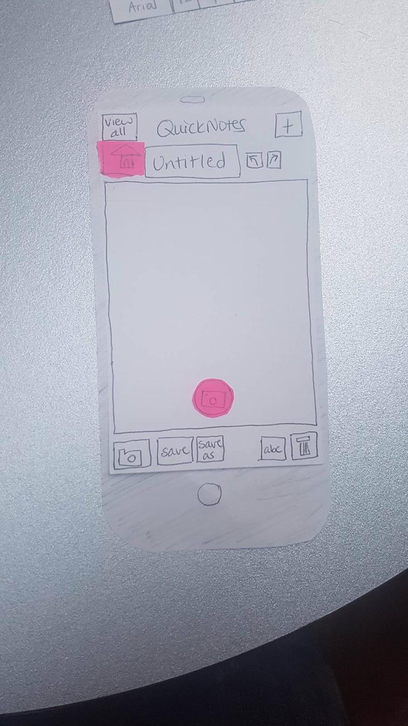
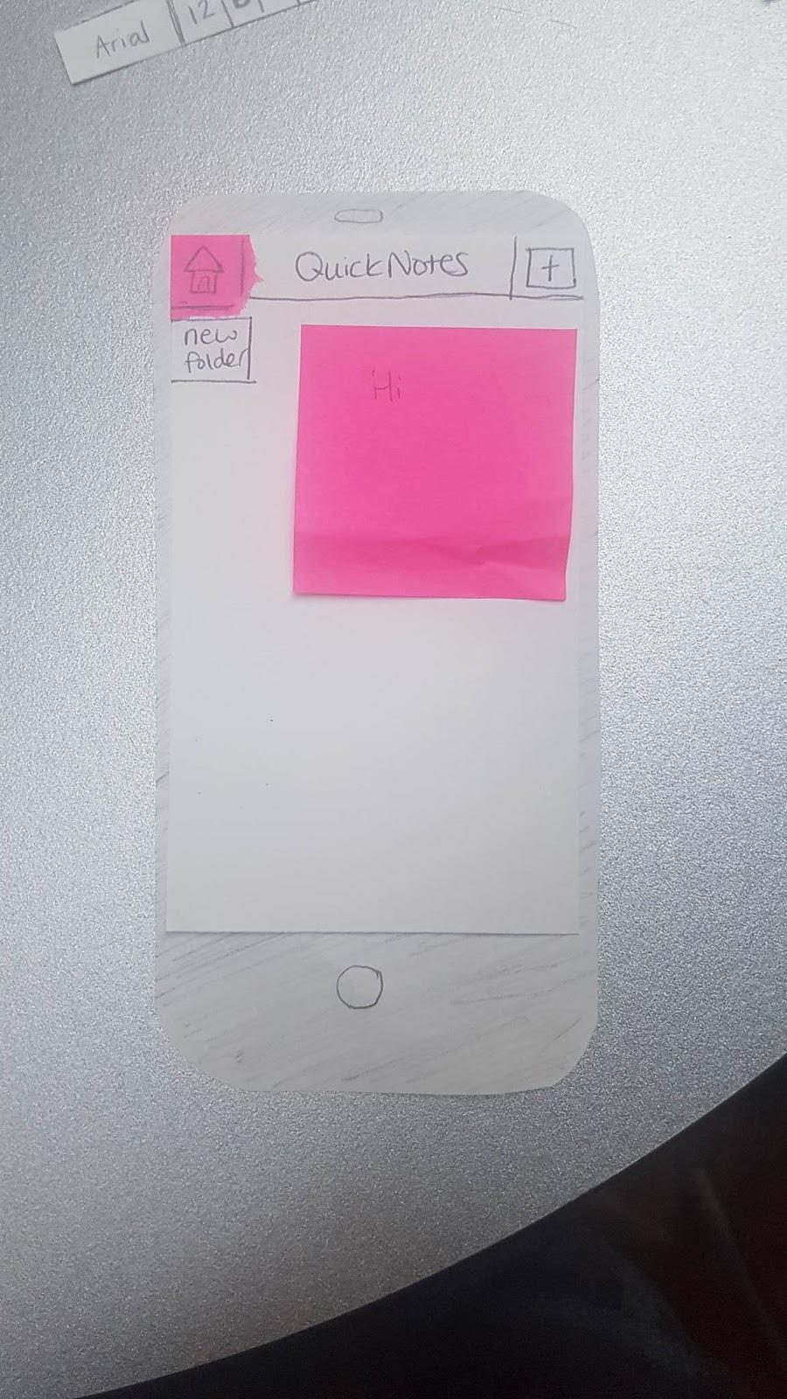
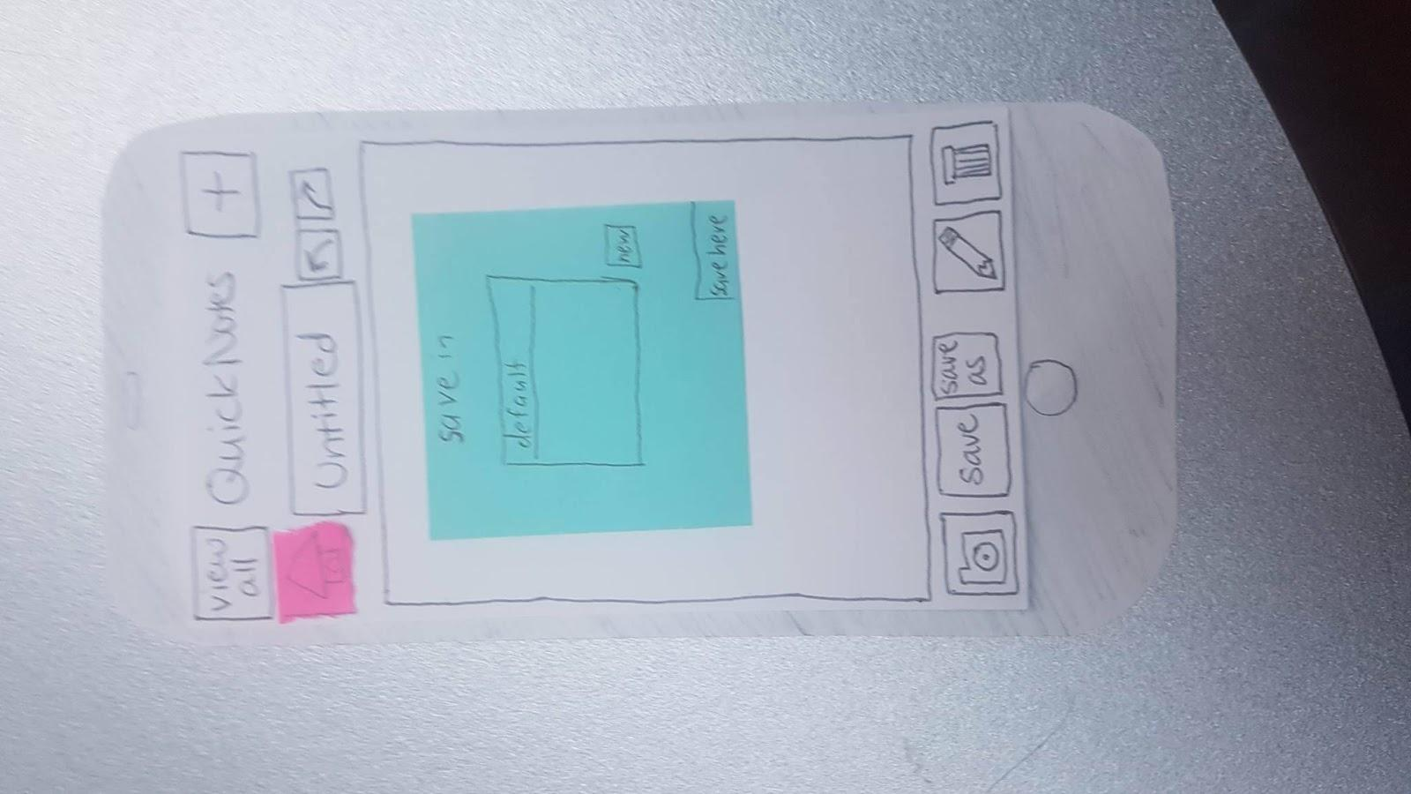
Task 1: Creating a new note and embedding a photo

Slide 9
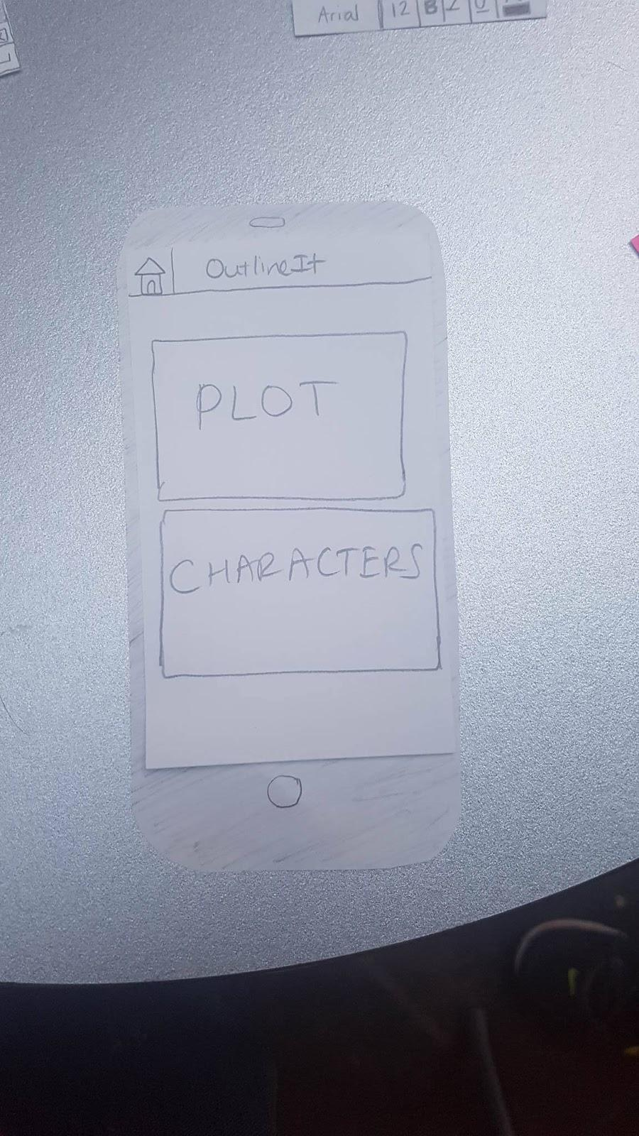
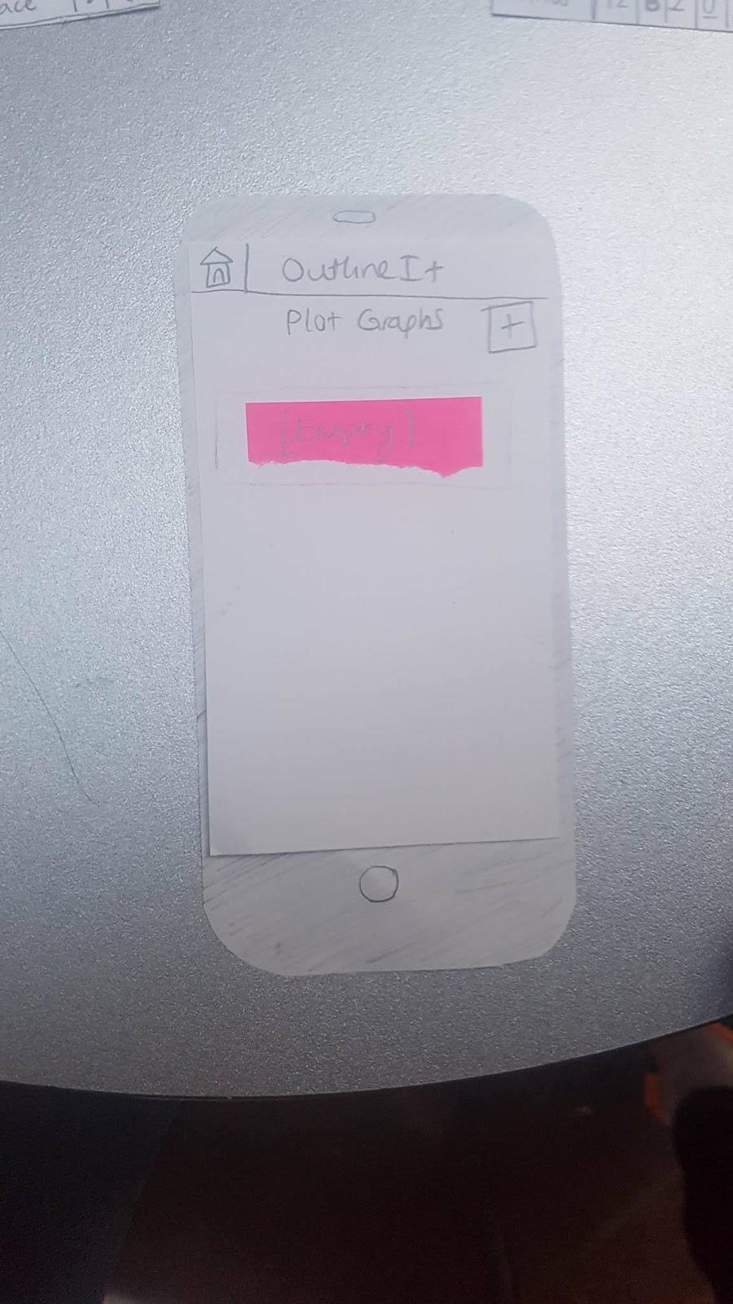
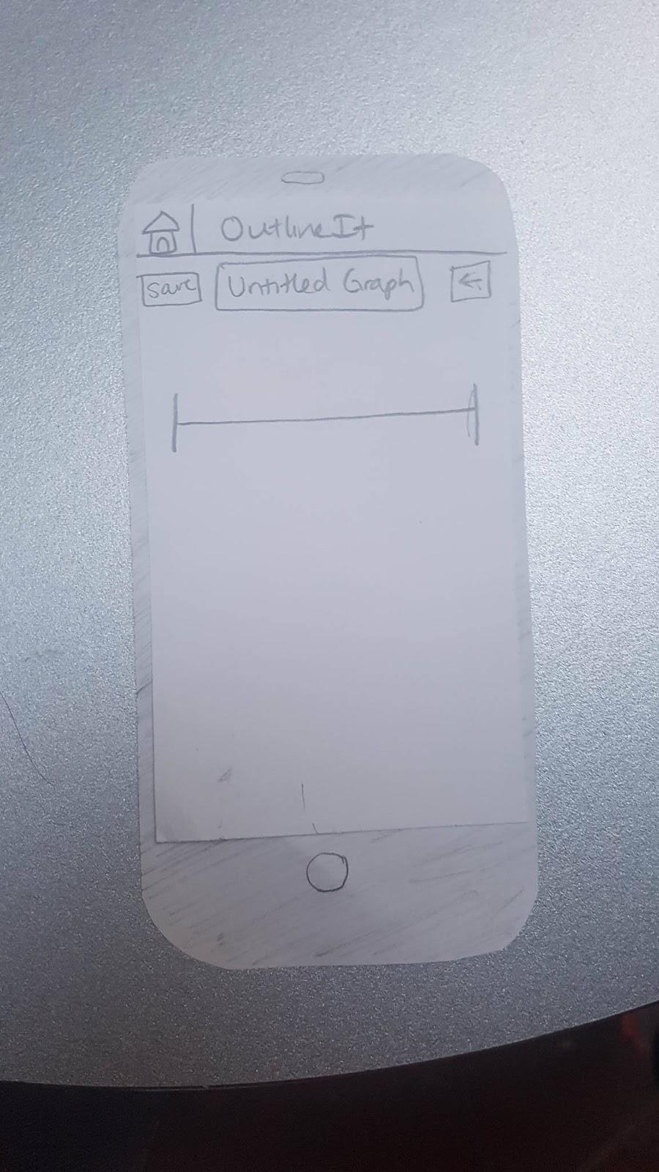
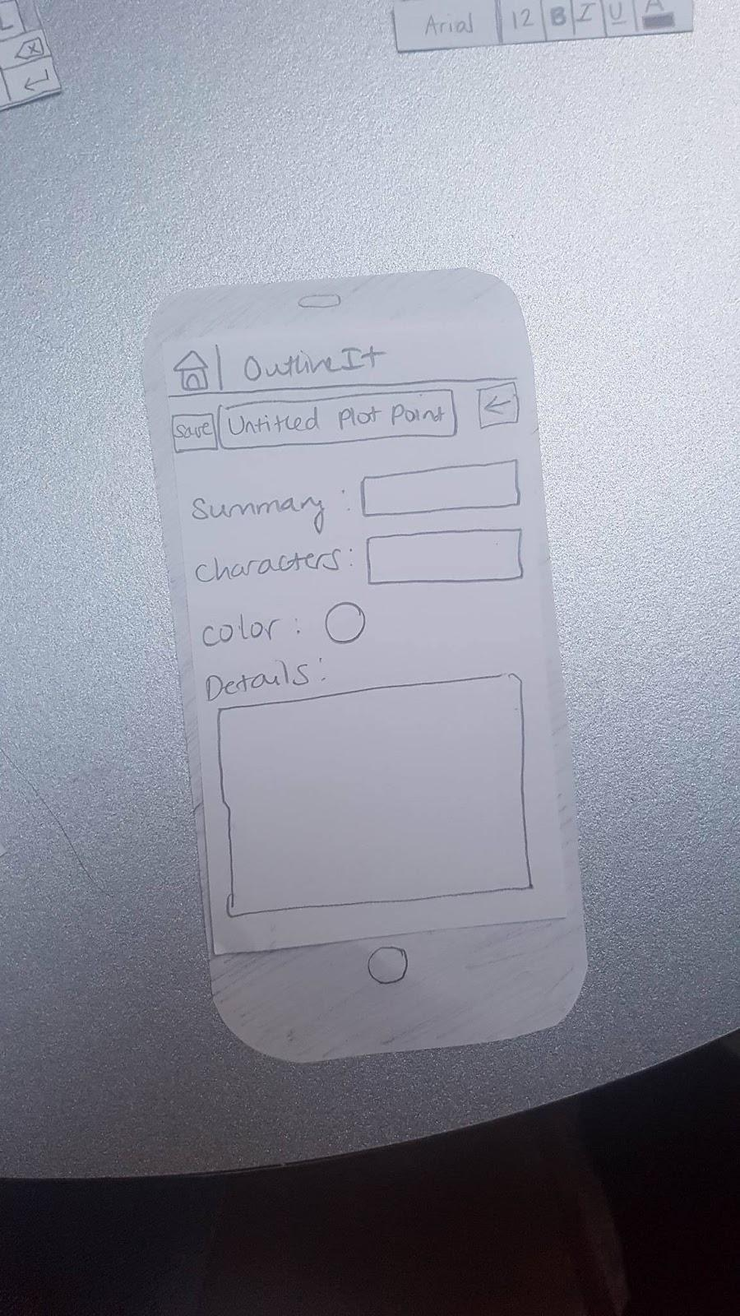
Task 2: Creating a plot graph, plot point, and character

Slide 10
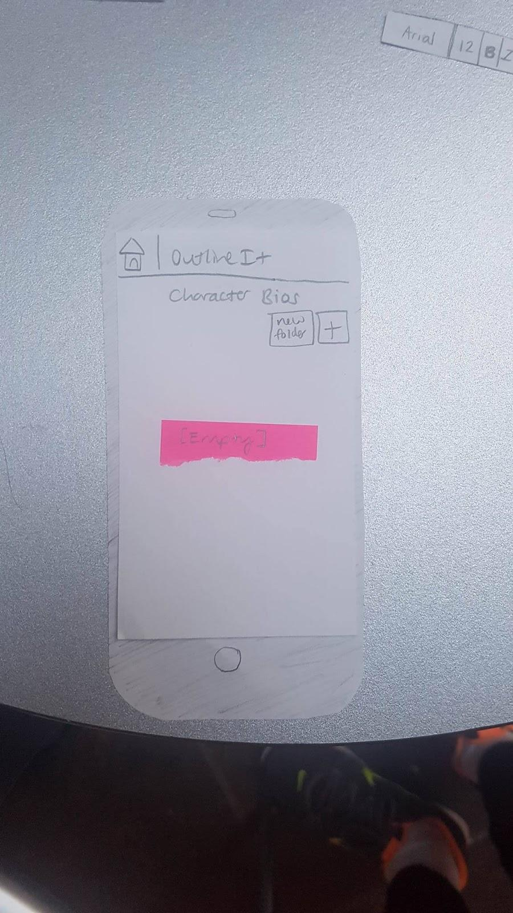
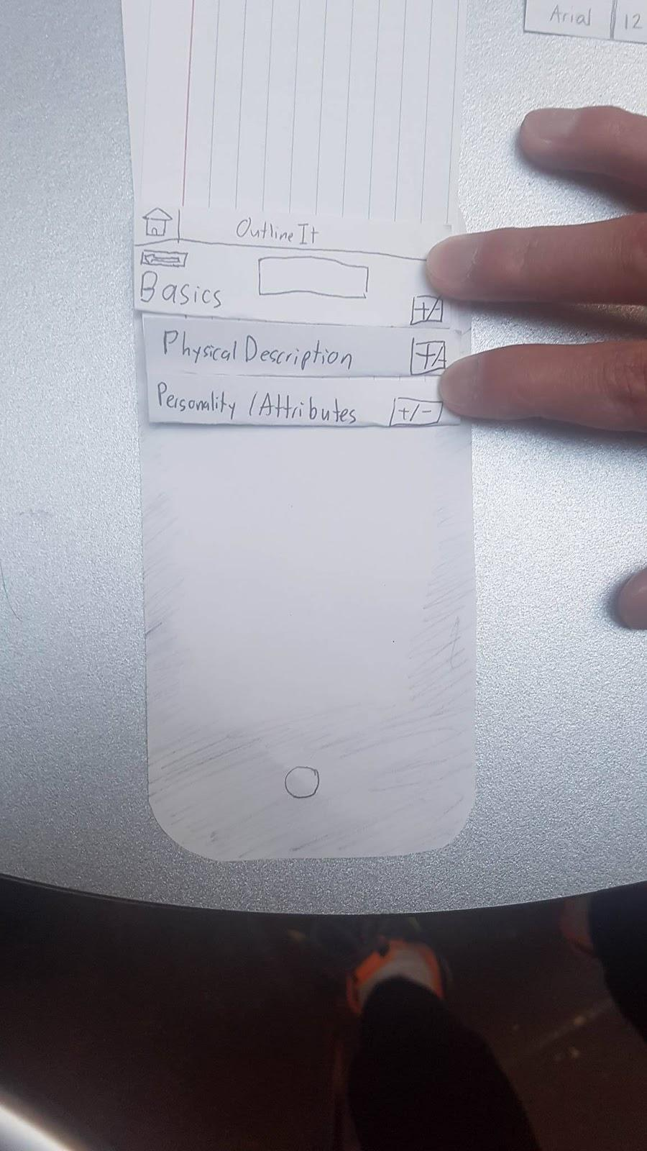
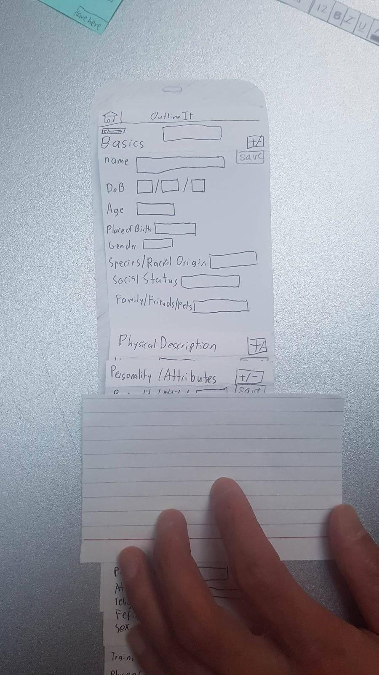
Task 2: Creating a plot graph, plot point, and character

Slide 11
Testing Process
Notes:
3.33.28

Slide 12
Testing Process
2 Heuristic Evaluations – classmates familiar with design experience, no writing background
3 Usability Tests – performed after redesign, students in CSE, no writing background

Slide 13
Testing Results

Slide 14
Heuristic Evaluation Results
Consistency –
back button
save/done button
overall layout

Slide 15
Heuristic Evaluation Results
Clutter – character biography
Too many entries
Four note cards

Slide 16
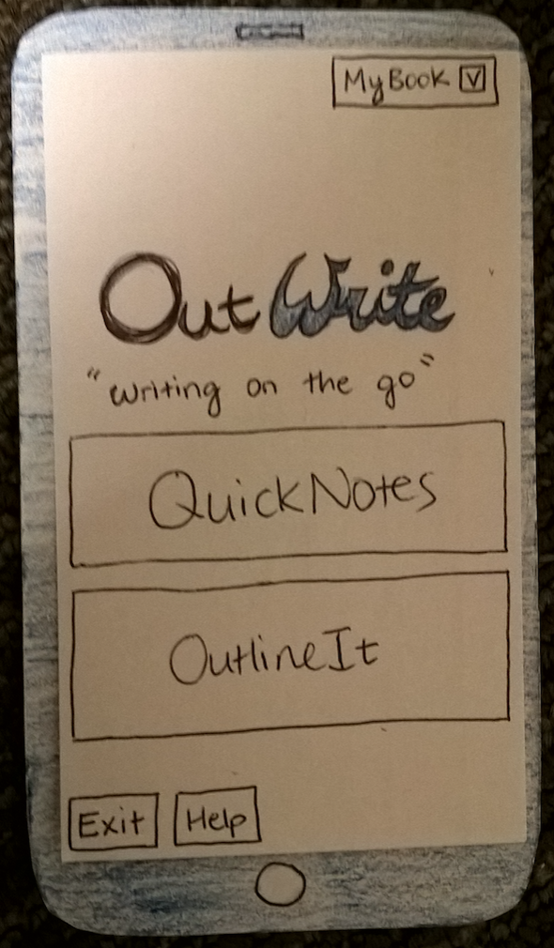
Heuristic Evaluation Results
Folder System
Confusing
Use MyBook and tags instead

Slide 17
Usability Test Results
New buttons helped participants – “New Note” button, Camera button, “Done” button for keyboard
Unnamed character error prevention
Character biography templates
Sorting of notes – sort by date/time and other features
Useful insights but no major overhaul compared to HE results

Slide 18
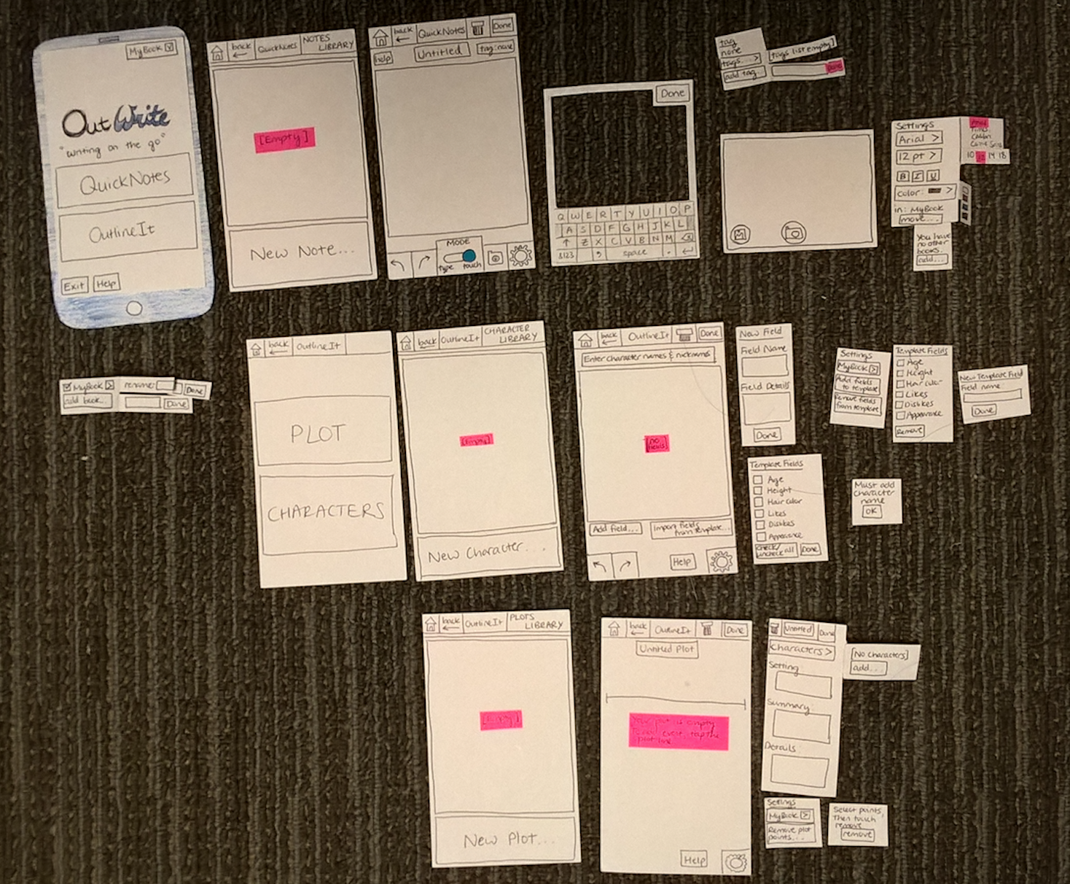
Final Prototype
Notes:
1.32.08

Slide 19
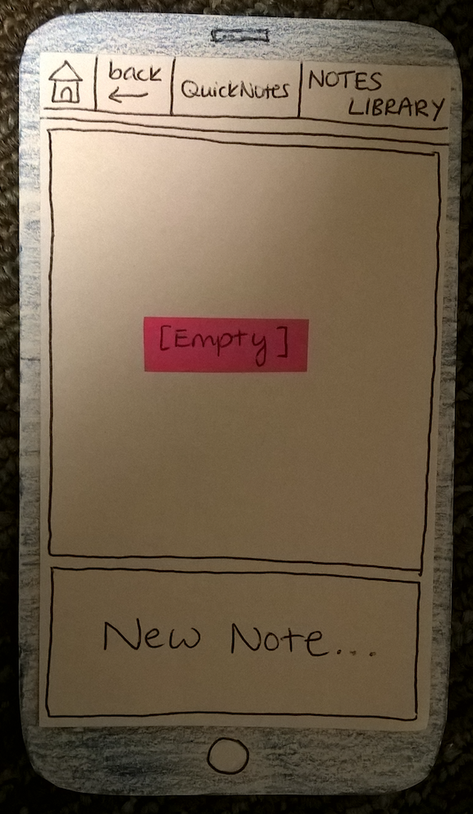
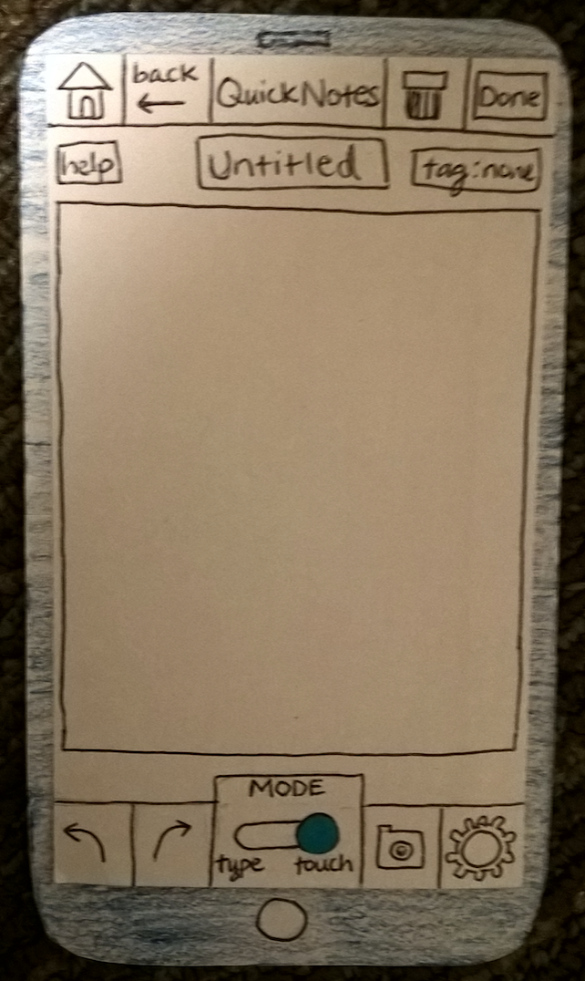
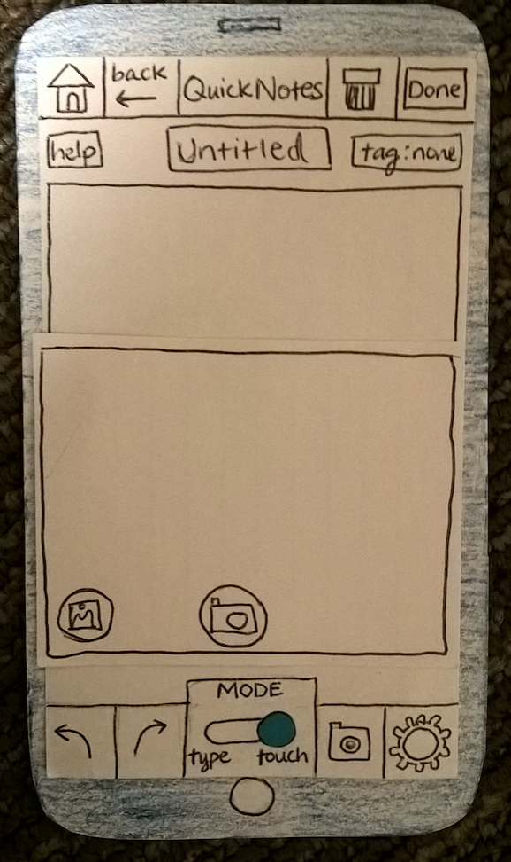
Task 1: Creating a new note and embedding a photo

Slide 20
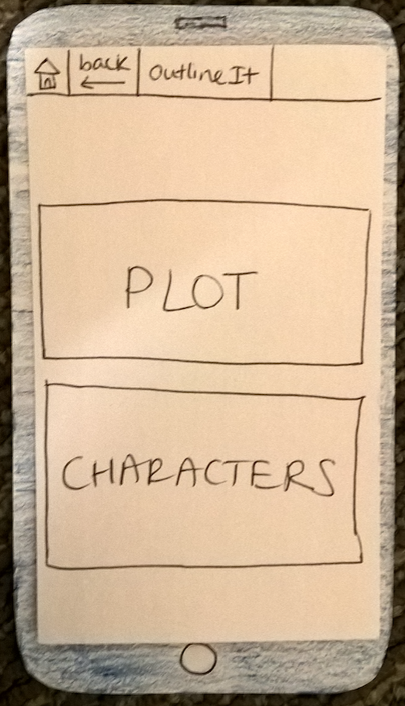
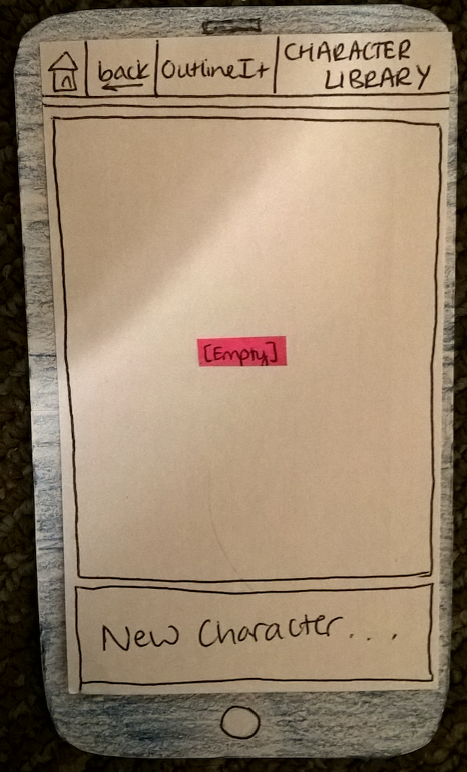
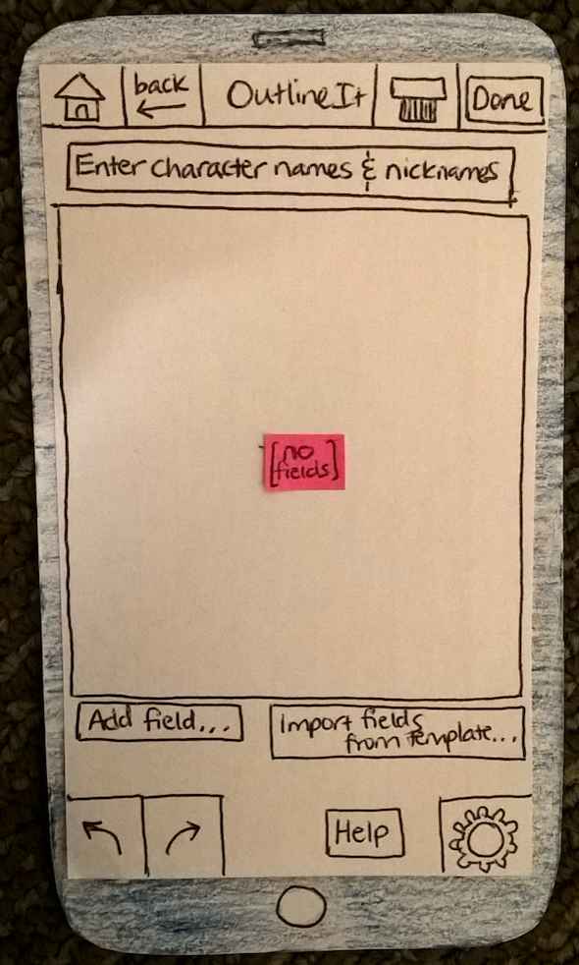
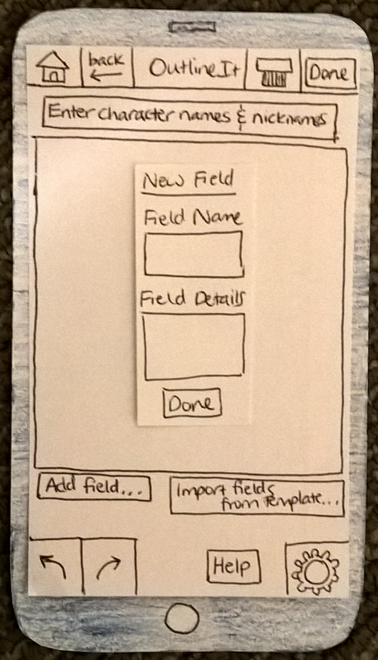
Task 2: Creating a plot graph, plot point, and character

Slide 21
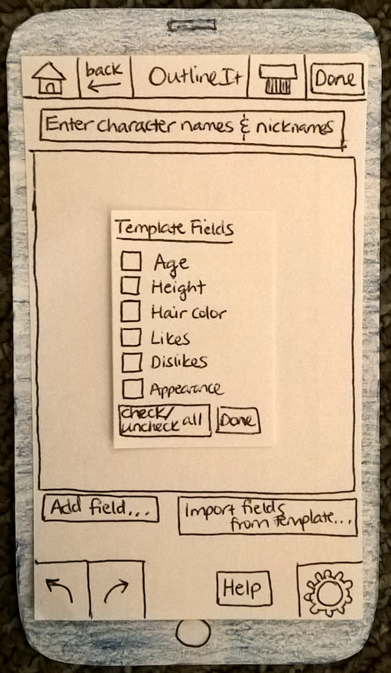
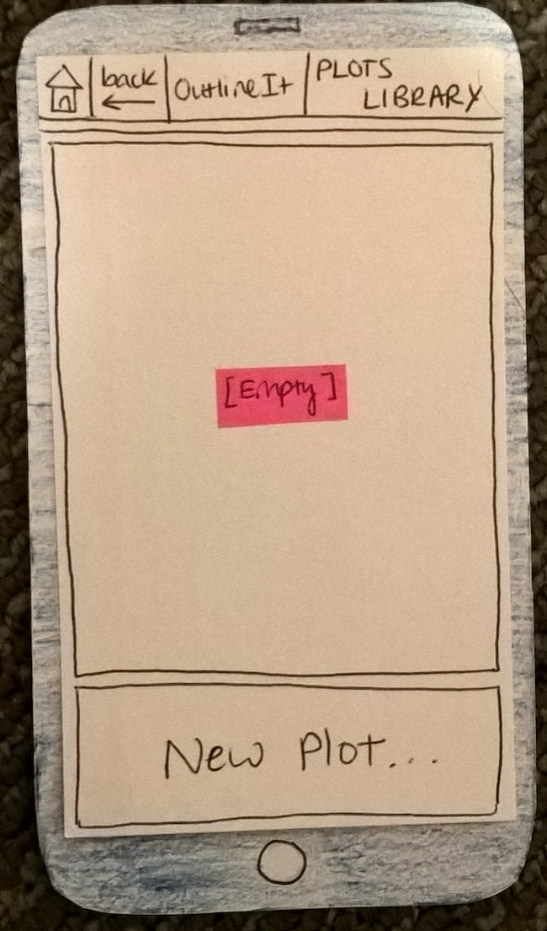
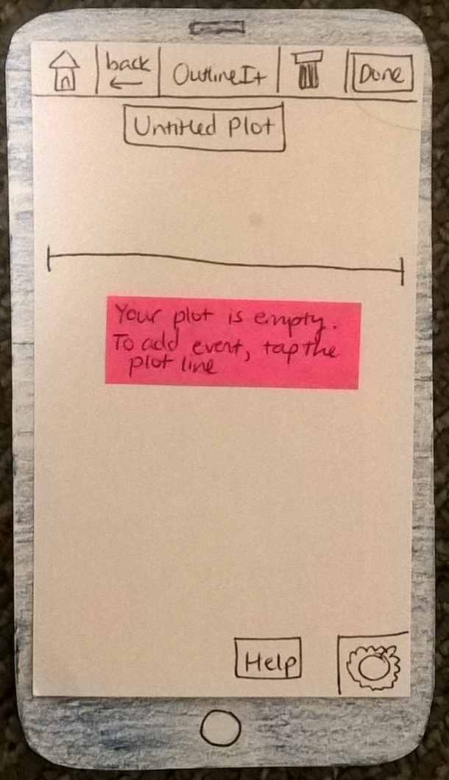
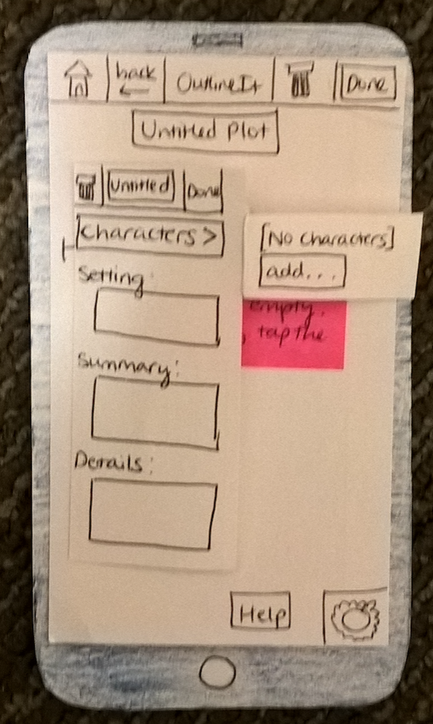
Task 2: Creating a plot graph, plot point, and character

Slide 22
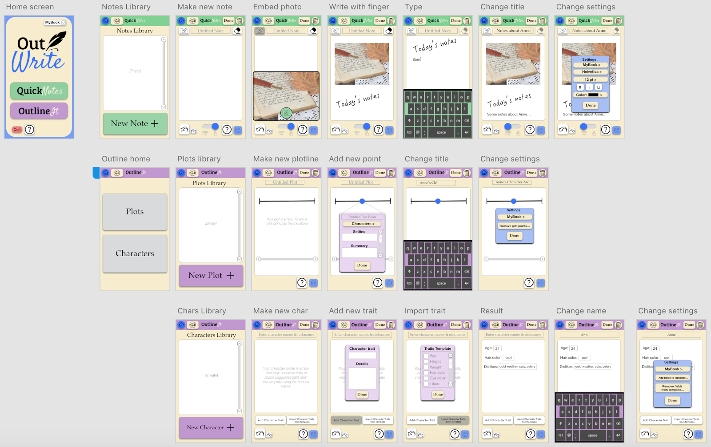
Digital Mockup
Icons from thenounproject.com
Notes:
1.33.46

Slide 23
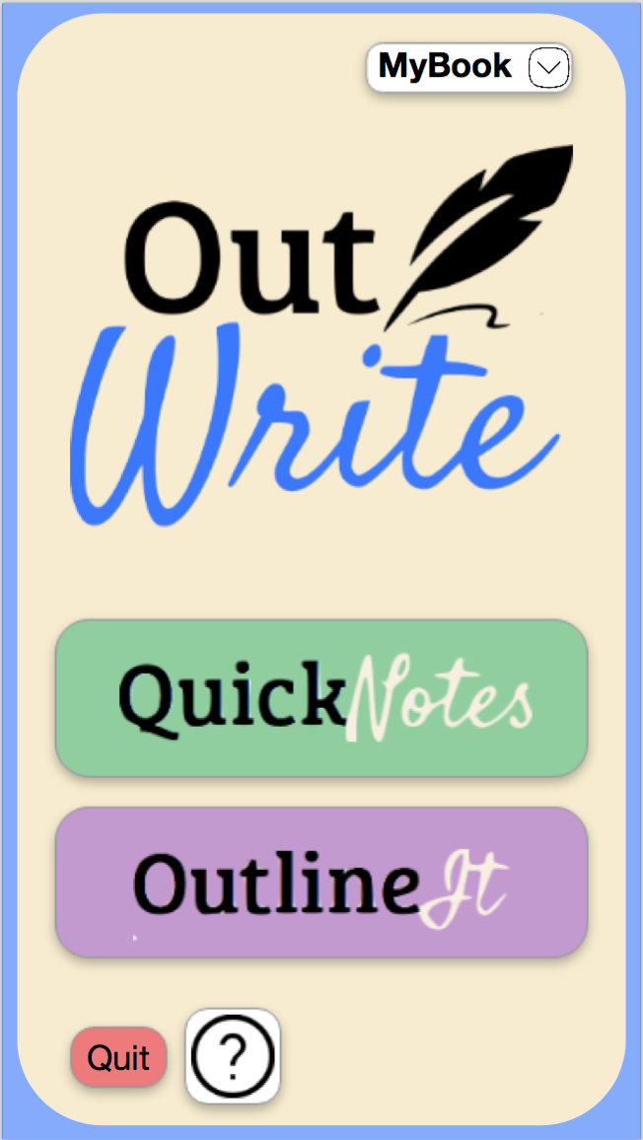
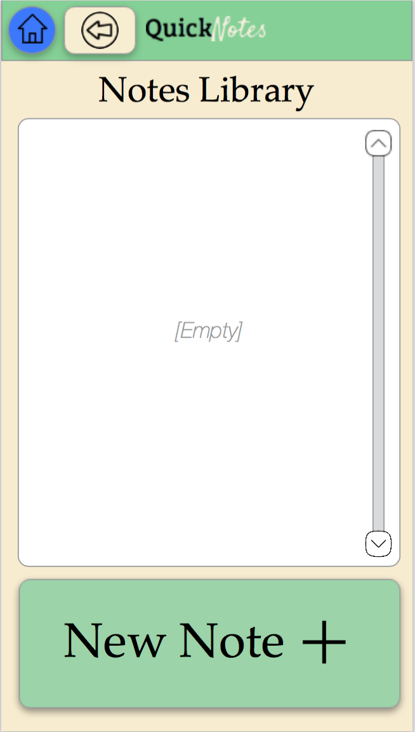
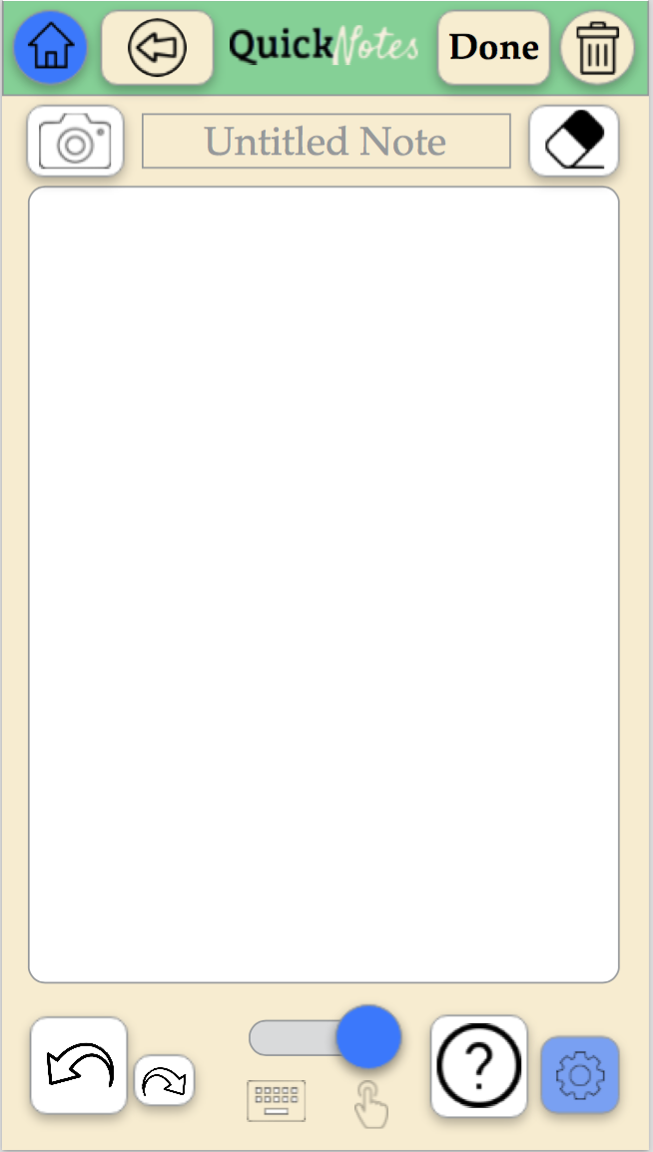
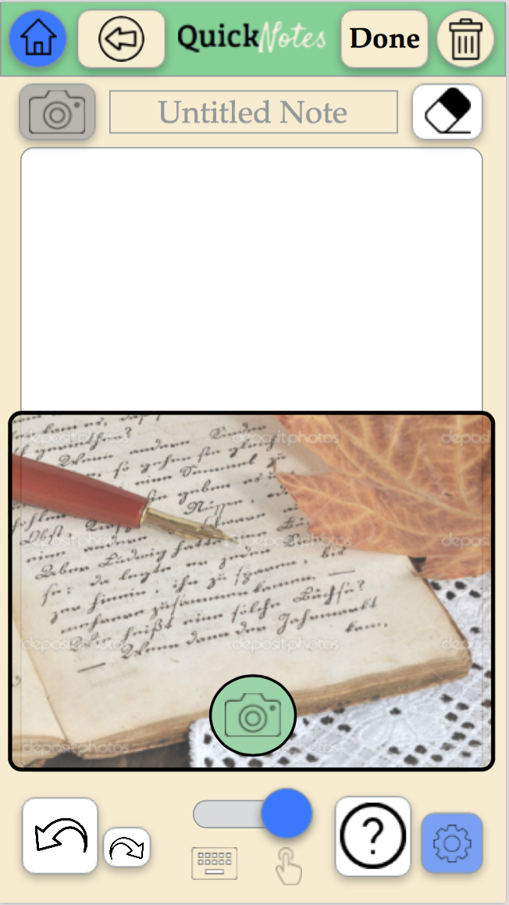
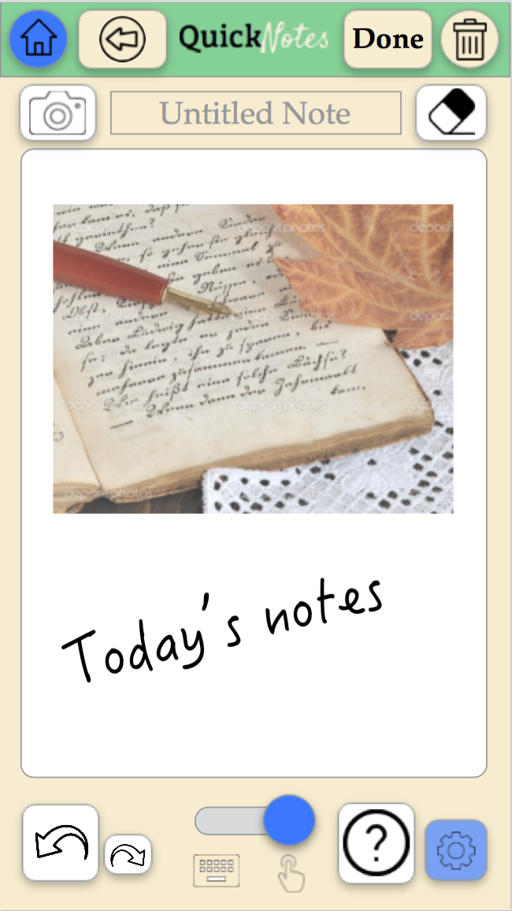
Task 1: Creating a new note and embedding a photo

Slide 24
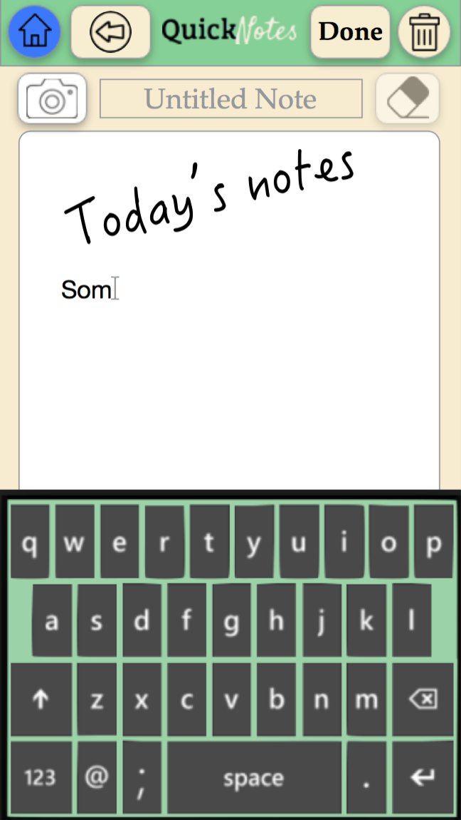
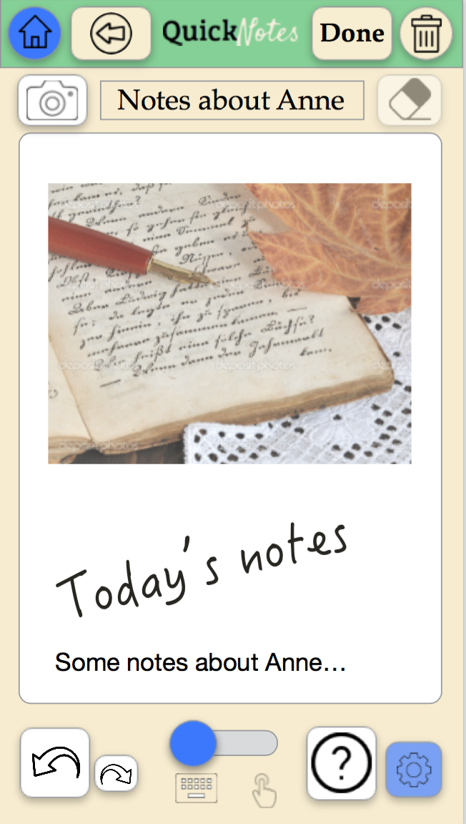
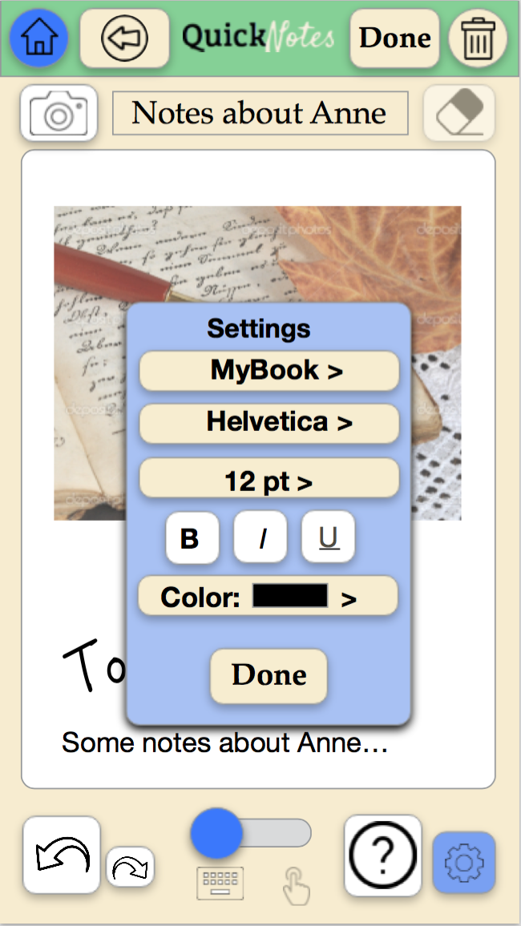
Task 1: Creating a new note and embedding a photo

Slide 25
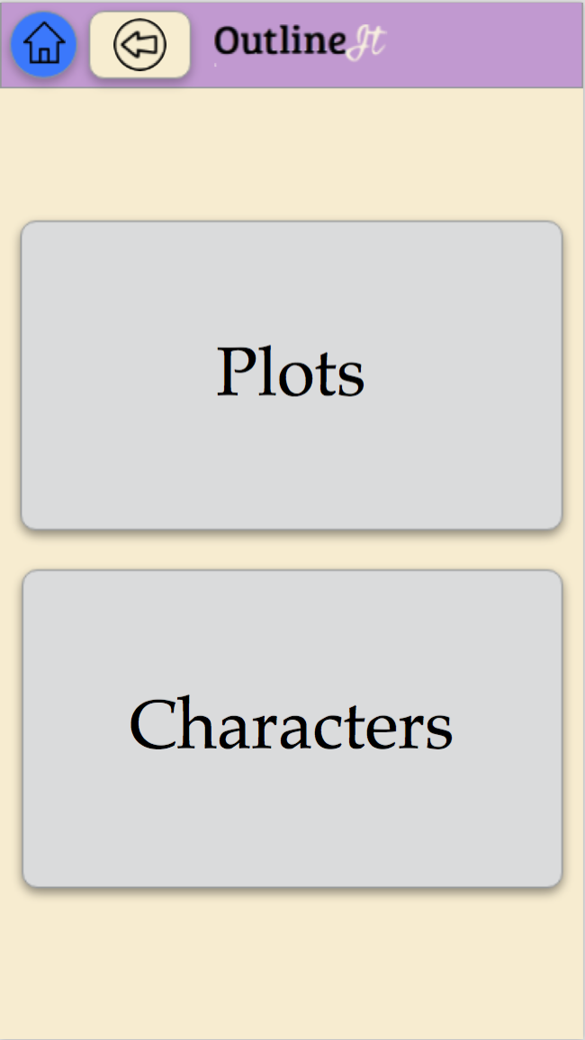
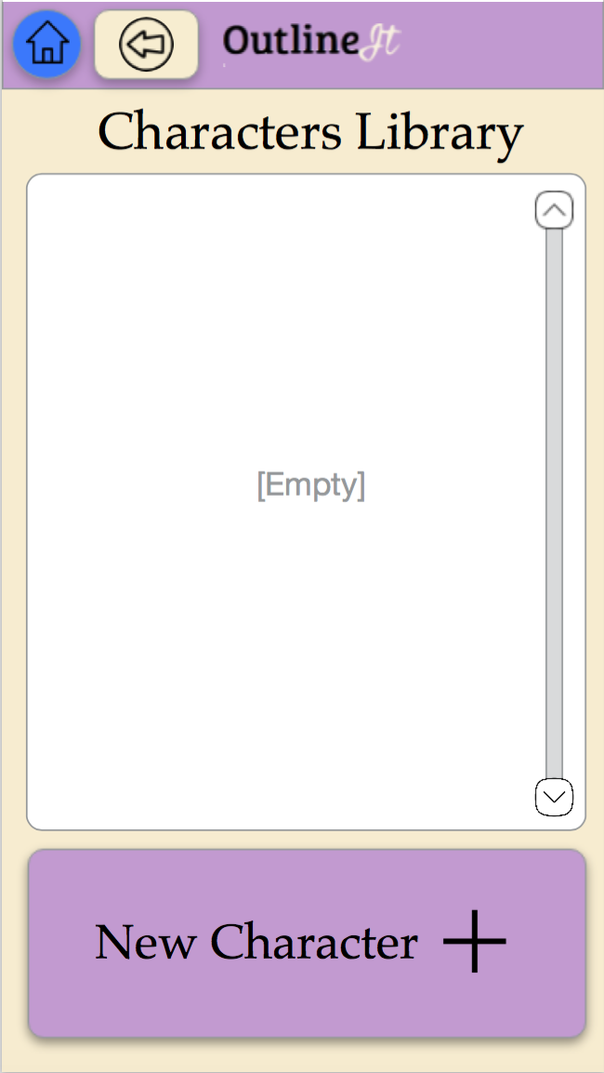
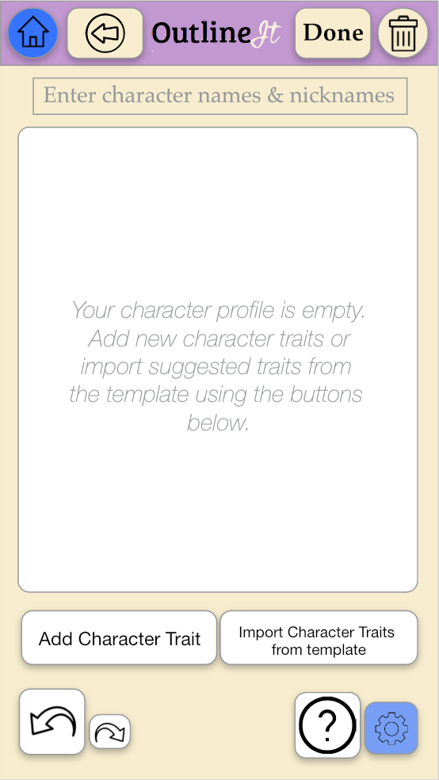
Task 2: Creating a plot graph, plot point, and character

Slide 26
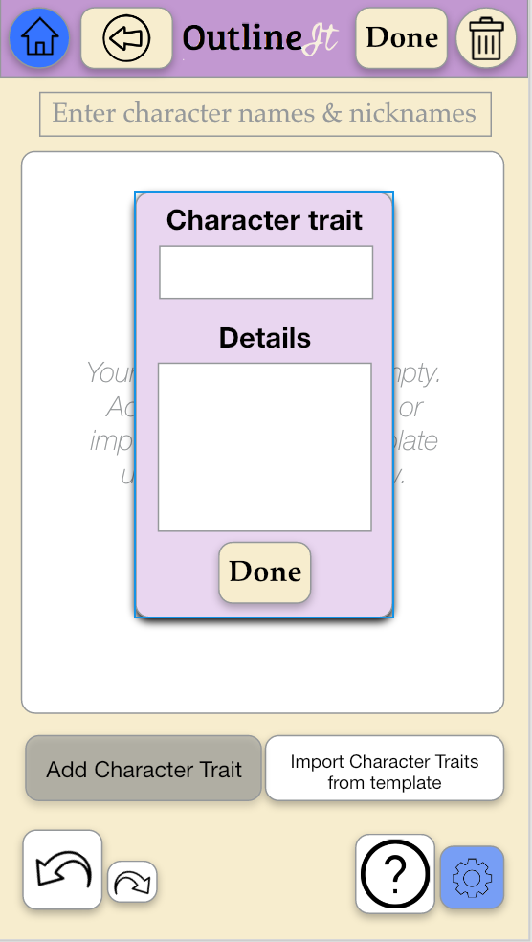
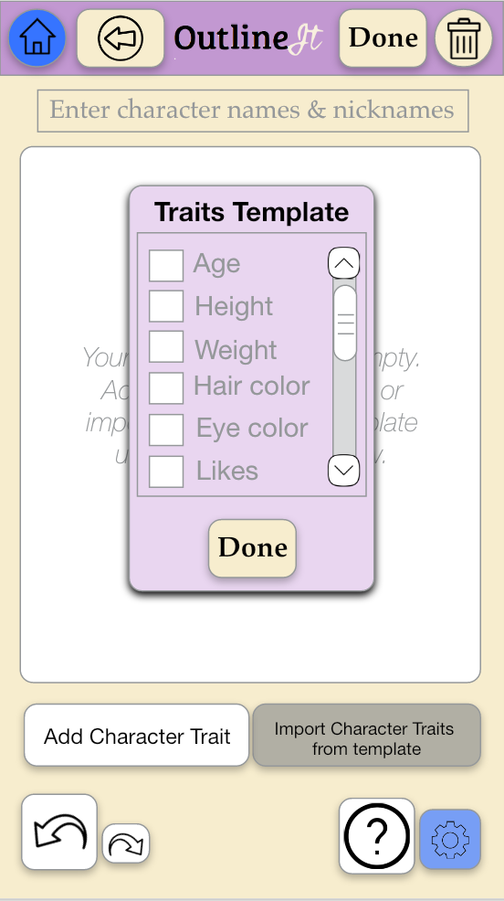
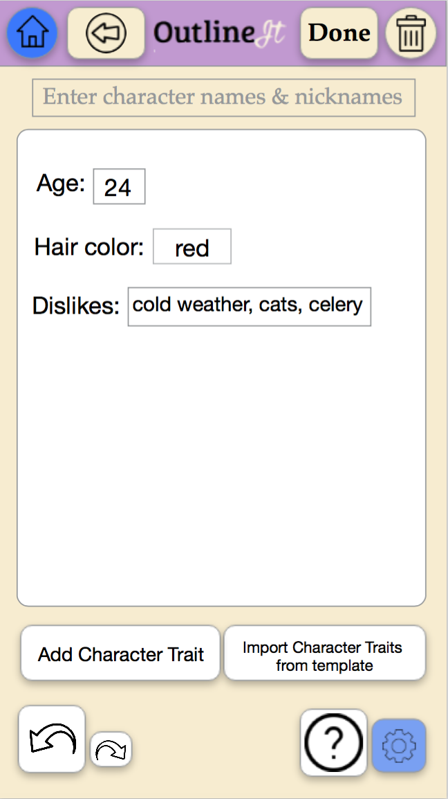
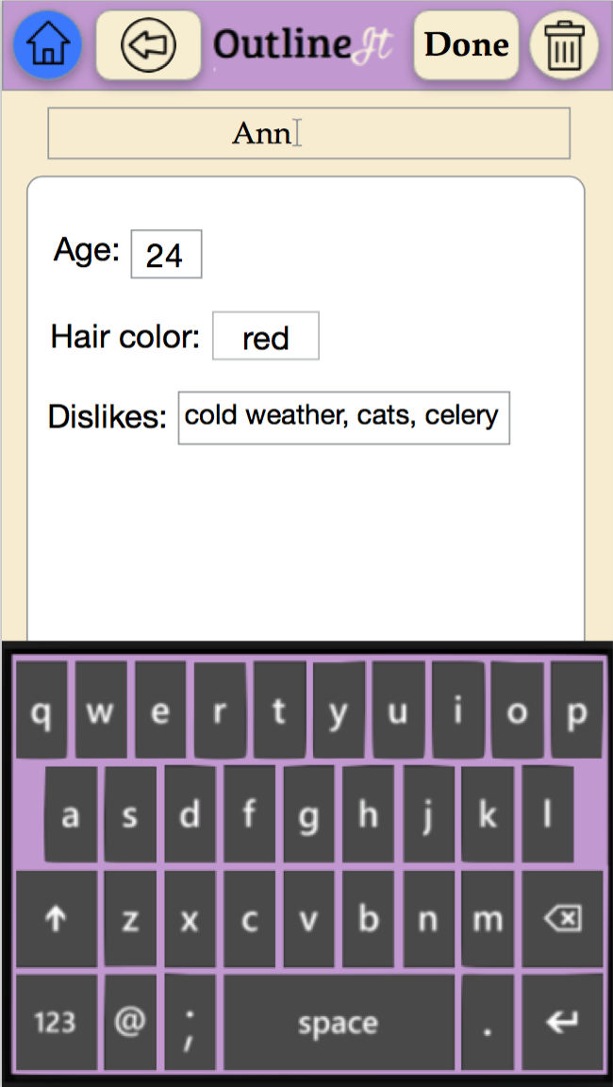
Task 2: Creating a plot graph, plot point, and character

Slide 27
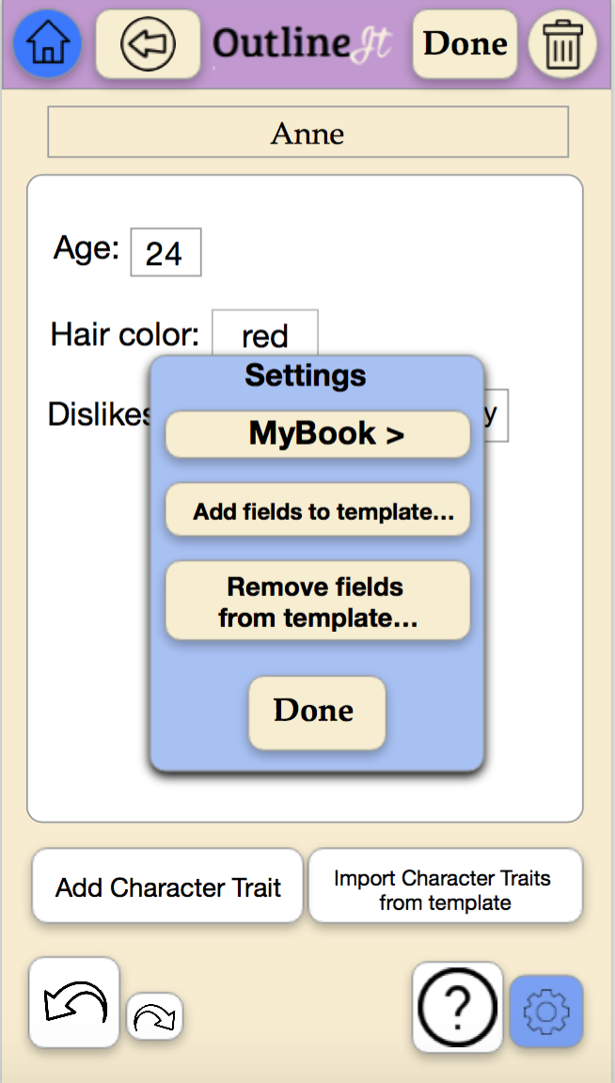
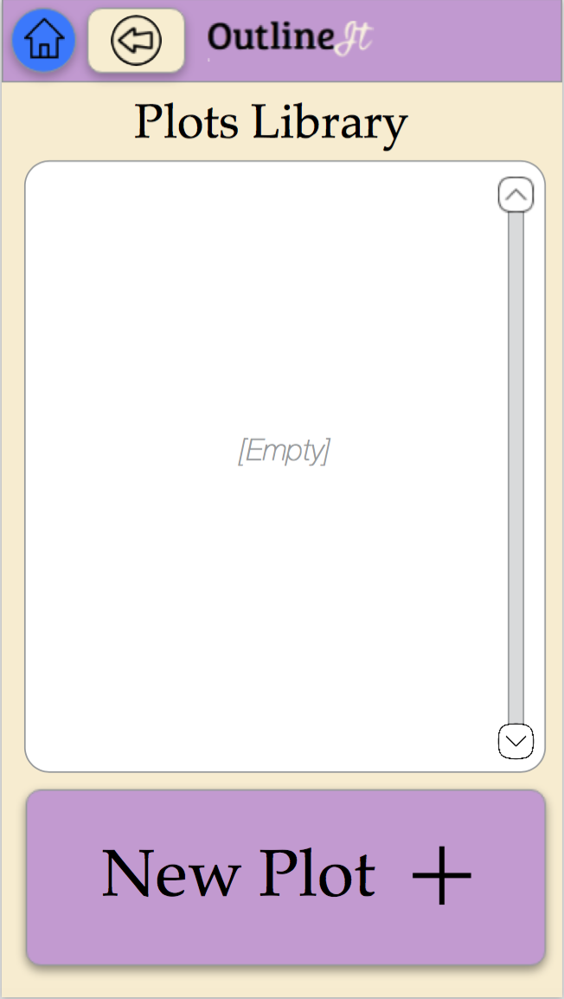
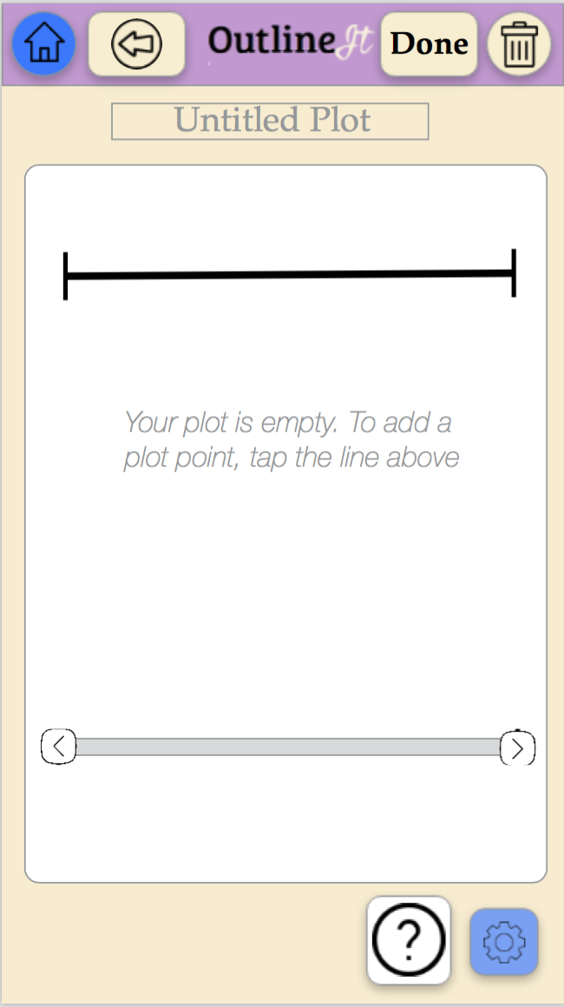
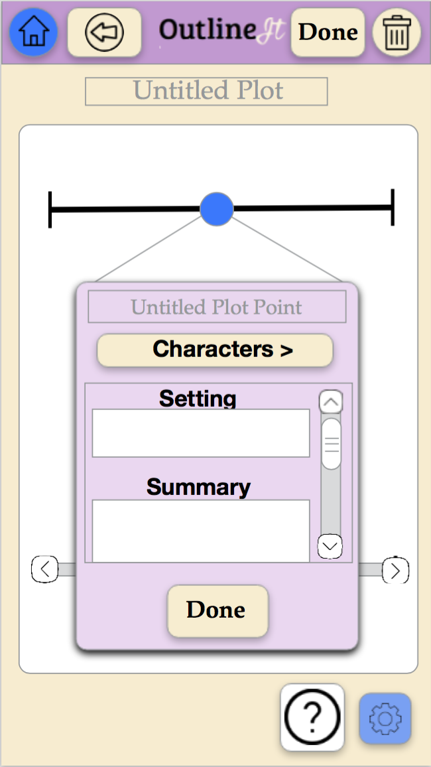
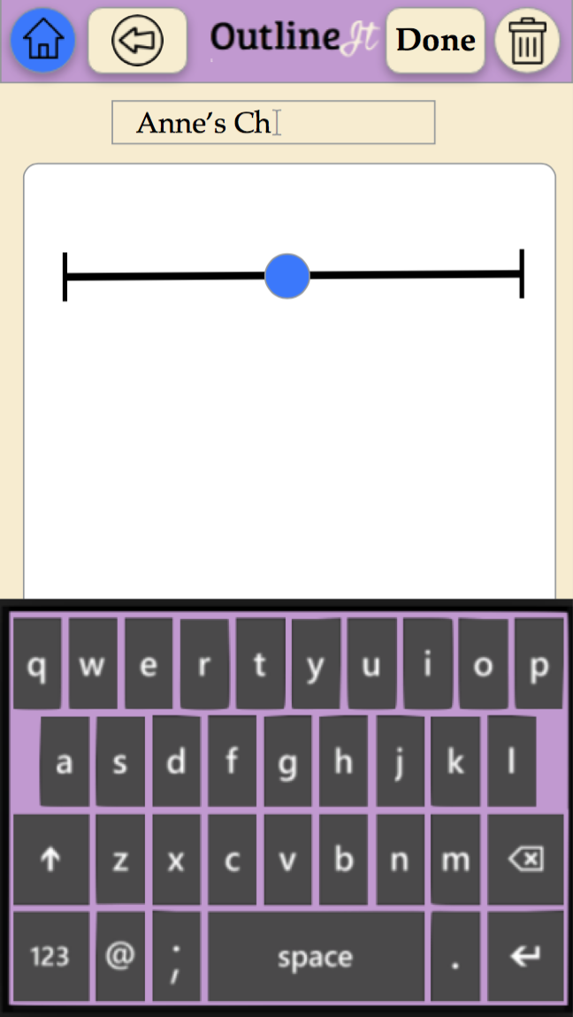
Task 2: Creating a plot graph, plot point, and character

Slide 28
Summary
Importance of iterations – the effort to create a logical design is not enough to prevent inconsistencies, holes and logical fallacies
At times, we had to backtrack our design
At times, the design process led us to modify our tasks
We are not the customers
Notes:
1.09.73

Slide 29
OutWrite
Image from thenounproject.com

